Slide 1
CLIPPERS
Used for the generation and shaping of waveforms
Used for the protection of circuits from spikes
Used for amplitude restorers
Used as voltage limiters
Used in television circuits
Used in FM transmitters

Slide 2
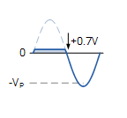
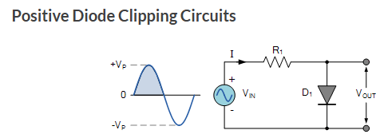
PN Diode Clippers
In this diode clipping circuit, the diode is forward biased (anode more positive than cathode) during the positive half cycle of the sinusoidal input waveform. For the diode to become forward biased, it must have the input voltage magnitude greater than +0.7 volts (0.3 volts for a germanium diode).
The diode begins to conduct and holds the voltage across itself constant at 0.7V until the sinusoidal waveform falls below this value. The output voltage across the diode can never exceed 0.7 volts during the positive half cycle.
During the negative half cycle, the diode is reverse biased (cathode more positive than anode) blocking current flow through itself and as a result has no effect on the negative half of the sinusoidal voltage which passes to the load unaltered. Thus the diode limits the positive half of the input waveform and is known as a positive clipper circuit.

Slide 3
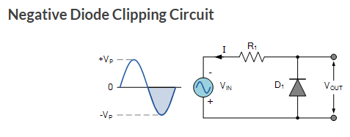
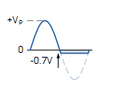
The diode is forward biased during the negative half cycle of the sinusoidal waveform and limits or clips it to –0.7 volts while allowing the positive half cycle to pass unaltered when reverse biased.
As the diode limits the negative half cycle of the input voltage it is therefore called a negative clipper circuit.

Slide 4
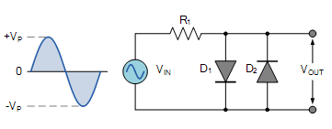
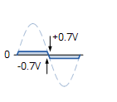
Clipping of Both Half Cycles
If two diodes in inverse parallel as shown, then both the positive and negative half cycles would be clipped as diode D₁ clips the positive half cycle of the sinusoidal input waveform while diode D₂ clips the negative half cycle. T

Slide 5
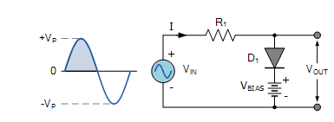

Slide 6
__V__L _ _C__E

Slide 7
S_I_CH

Slide 8
R_ _I_ _ER

Slide 9
_ _ PP_E

Slide 10
R__C__I __ __ E__

Slide 11
D__ __ L_T __ __ N

Slide 12
Clampers
Used as direct current restorers
Used to remove distortions
Used as voltage multipliers
Used for the protection of amplifiers
Used as test equipment
Used as base-line stabilizer

Slide 13
PN Diode – Clamping Circuits
A Clamper Circuit is a circuit that adds a DC level to an AC signal. Actually, the positive and negative peaks of the signals can be placed at desired levels using the clamping circuits. As the DC level gets shifted, a clamper circuit is called as a Level Shifter.
A Clamper circuit can be defined as the circuit that consists of a diode, a resistor and a capacitor that shifts the waveform to a desired DC level without changing the actual appearance of the applied signal.

Slide 14
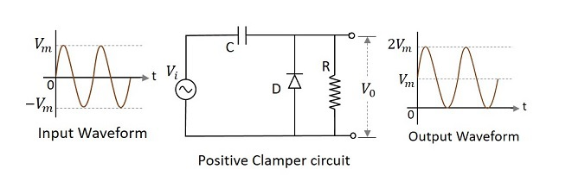
Positive Clamper Circuit
A Clamping circuit restores the DC level. When a negative peak of the signal is raised above to the zero level, then the signal is said to be positively clamped.
Initially when the input is given, the capacitor is not yet charged and the diode is reverse biased. The output is not considered at this point of time. During the negative half cycle, at the peak value, the capacitor gets charged with negative on one plate and positive on the other. The capacitor is now charged to its peak value Vm. The diode is forward biased and conducts heavily.
During the next positive half cycle, the capacitor is charged to positive Vm while the diode gets reverse biased and gets open circuited. The output of the circuit at this moment will be V0=Vi+Vm

Slide 15
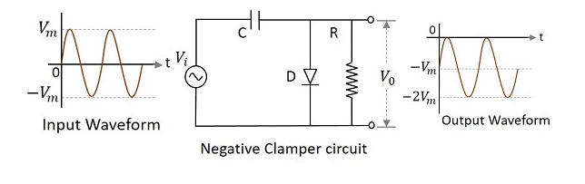
Negative Clamper Circuit
A Negative Clamper circuit is one that consists of a diode, a resistor and a capacitor and that shifts the output signal to the negative portion of the input signal.
During the positive half cycle, the capacitor gets charged to its peak value Vm. The diode is forward biased and conducts. During the negative half cycle, the diode gets reverse biased and gets open circuited. The output of the circuit at this moment will be V0=Vi+Vm. Hence the signal is negatively clamped

Slide 16

Diode Current Equation
The diode current equation expresses the relationship between the current flowing through the diode as a function of the voltage applied across it. Mathematically the diode current equation can be expressed as:
where,
I₀ is the dark saturation current,
q is the charge on the electron,
V is the voltage applied across the diode,
η is the (exponential) ideality factor.
I is the current flowing through the diode
k is the Boltzmann constant
T is the absolute temperature in Kelvin.
The value of η is typically considered to be 1 for germanium diodes and 2 for silicon diodes

Slide 17
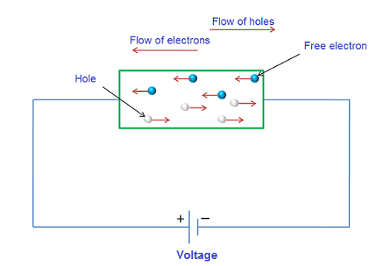
Drift current
The flow of charge carriers, which is due to the applied voltage or electric field is called drift current.
In a semiconductor, there are two types of charge carriers, they are electrons and holes. When the voltage is applied to a semiconductor, the free electrons move towards the positive terminal of a battery and holes move towards the negative terminal of a battery.
The average velocity that an electron or hole achieved due to the applied voltage or electric field is called drift velocity.
The drift velocity of electrons is given by V_{n} = µ_{n}E
The drift velocity of holes is given by V_{p} = µ_{p}E
where
v_{n} = drift velocity of electrons
v_{p} = drift velocity of holes
µ_{n} = mobility of electrons
µ_{p} = mobility of holes
E = applied electric field

Slide 18
The drift current density due to free electrons is given by
J_{n}= enµ_{n}E
The drift current density due to holes is given by
J_{p} = epµ_{p}E
where J_{n} = drift current density due to electrons
J_{p} = drift current density due to holes
e = charge of an electron = 1.602 × 10⁻¹⁹ Coulombs (C).
n = number of electrons
p = number of holes
Then the total drift current density is
J = J_{n} + J_{p}
= enµ_{n}E + epµ_{p}E
J = e (nµ_{n} + pµ_{p}) E

Slide 19
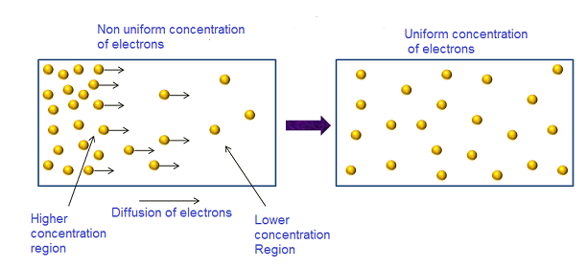




Diffusion Current
The process by which, charge carriers (electrons or holes) in a semiconductor moves from a region of higher concentration to a region of lower concentration is called diffusion.
The region in which more number of electrons is present is called higher concentration region and the region in which less number of electrons is present is called lower concentration region.
Current produced due to motion of charge carriers from a region of higher concentration to a region of lower concentration is called diffusion current. Diffusion process occurs in a semiconductor that is non-uniformly doped.
The concentration gradient for n-type semiconductor is given by
The concentration gradient for p-type semiconductor is given by
Where J_{n} = diffusion current density due to electrons
J_{p} = diffusion current density due to holes
The diffusion current density due to electrons is given by
The diffusion current density due to holes is given by

